Slide 1
Business Data Communications
Fourteenth Edition
Jerry FitzGerald, Alan Dennis, and Alexandra Durcikova
Chapter 11
Network Security

Slide 2
Learning Objectives
Be familiar with the major threats to network security.
Be familiar with how to conduct a risk assessment.
Develop an understanding of ensuring business continuity
Develop an understanding of preventing intrusion.

Slide 3
11.1 Introduction
With the Internet, companies face global threats to their networks and, more importantly, to their data.
Malware has long been a problem.
Credit card theft and identity theft are fast-growing.
Computer security has become increasingly important with the Sarbanes-Oxley Act (SOX) and the Health Insurance Portability and Accountability Act (HIPAA).
A company of any size can be the target of a cyberattack.

Slide 4
Three Main Reasons for an Increase in Computer Security
In the past, hacking into somebody’s computer was considered to be a hobby, but today being a cybercriminal is a profession.
Hacktivism (the use of hacking techniques to bring attention to a larger political or social goal) has become more common.
The increase in mobile devices offers a very fertile environment for exploitation.

Slide 5
Why Networks Need Security
In recent years, organizations have become increasingly dependent on data communication networks.
The losses associated with security failures can be huge.
An average data breach costs about $3.5 million.
Protecting customer privacy and the risk of identity theft also drive the need for increased network security.

Slide 6
Types of Security Threats
There are three primary goals in providing security:
Confidentiality refers to the protection of organizational data from unauthorized disclosure of customer and proprietary data.
Integrity is the assurance that data have not been altered or destroyed.
Availability means providing continuous operation of the organization’s hardware and software.
Threats can be classified into two broad categories:
Ensuring business continuity refers primarily to ensuring availability, with some aspects of data integrity.
Three main threats: disruptions, destruction, and disasters.
Preventing unauthorized access refers primarily to confidentiality, but also integrity, as an intruder may change important data.

Slide 7
Network Controls
Developing a secure network means developing controls.
Controls are software, hardware, rules, or procedures that reduce or eliminate the threats to network security.
Types of controls:
Preventive controls mitigate or stop a person from acting or an event from occurring
Detective controls reveal or discover unwanted events.
Corrective controls remedy an unwanted event or an intrusion.
Controls must be reviewed periodically.

Slide 8
QUIZ 1
Security on a network not only means being able to prevent a hacker from breaking into your computer but also includes being able to recover from temporary service problems or from natural disasters. TRUE/FALSE)?
Ans: True

Slide 9
QUIZ 2
The rise of the Internet has increased significantly the potential vulnerability of an organization’s assets. (TRUE/FALSE)?
Ans: True

Slide 10
QUIZ 3
Maintaining data integrity is not a primary goal of security (TRUE/FALSE)?
Ans: False

Slide 11
QUIZ 4
Business continuity planning refers primarily to ensuring availability, with some aspects of data integrity. (TRUE/FALSE)?
Ans: True

Slide 12
QUIZ 5
Which of the following is not one of the major categories (or sub-categories) into which network security threats can be placed?
disruption
destruction
controlled chaos
intrusion
disaster
Ans: c. Controlled chaos

Slide 13
11.2 Risk Assessment
The first step in developing a secure network is to conduct a risk assessment.
There are several commonly used risk assessment frameworks that provide strategies for analyzing and prioritizing the security risks:
Operationally Critical Threat, Asset, and Vulnerability Evaluation (OCTAVE).
Control Objectives for Information and Related Technology (COBIT).
Risk Management Guide for Information Technology Systems (NIST guide).

Slide 14
Common Steps to Risk Assessment
Develop risk measurement criteria
Inventory IT assets
Identify threats
Document existing controls.
Identify improvements.

Slide 15
Develop Risk Measurement Criteria
Risk measurement criteria are the measures used to evaluate the way a security threat could affect the organization.
Each organization needs to develop its own set of potential business impacts.
Five most common are:
Financial (revenues and expenses)
Productivity
Reputation
Safety
Legal

Slide 16
Develop Risk Measurement Criteria Continued
Once the impact areas have been identified, the next step is to prioritize them.
The next step is to develop specific measures of what could happen in each impact area and what we would consider a high, medium, and low impact.

Slide 17
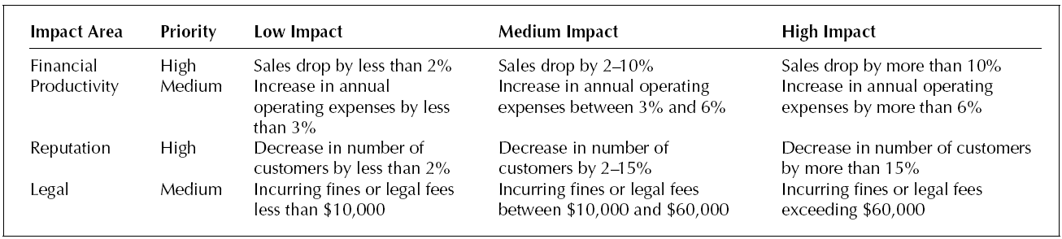
Sample Risk Measurement Criteria for a Web-Based Bookstore

Slide 18
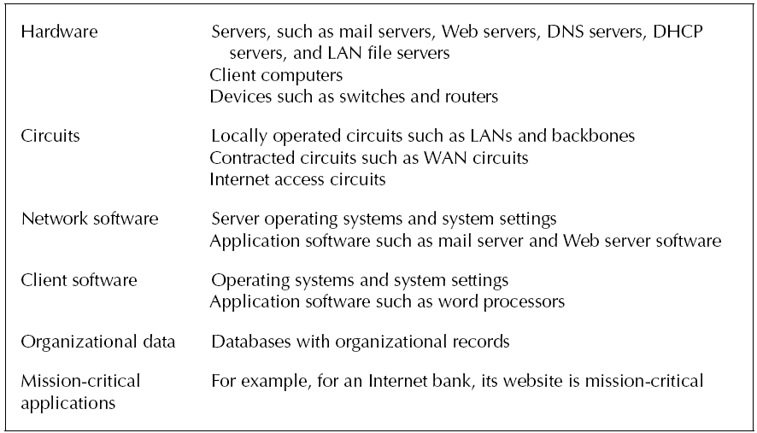
Inventory IT Assets
An asset is something of value and can be either hardware, software, data, or applications
An important type of asset is the mission-critical application.
The next most important type of asset is the organization’s data.
Once all assets are identified, they need to be rated for importance.

Slide 19
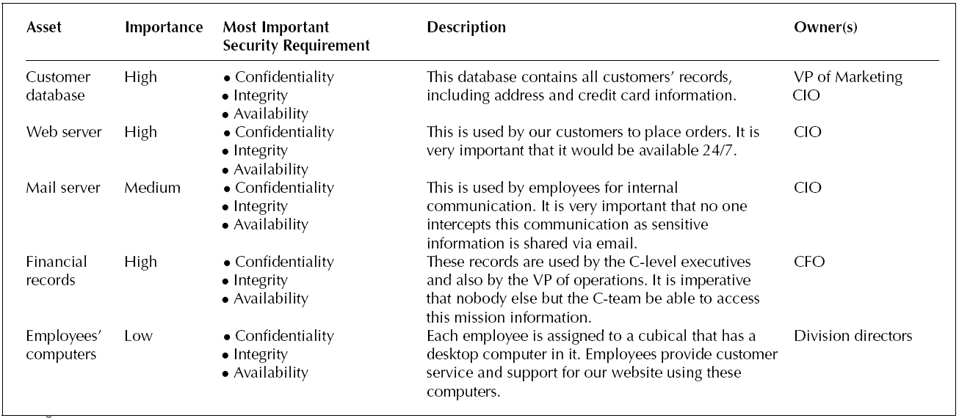
Sample Inventory of Assets for a Web-Based Bookstore

Slide 20
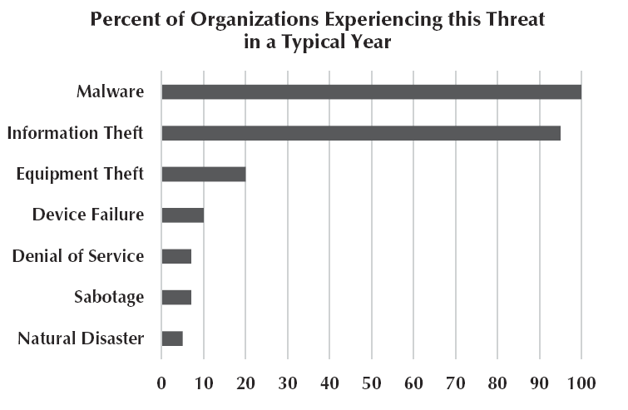
Identify Threats
A threat is any potential occurrence that can do harm, interrupt the systems using the network, or cause a monetary loss to the organization.
The actual probability of a threat to your organization depends on your business.
The next step is to create threat scenarios.

Slide 21
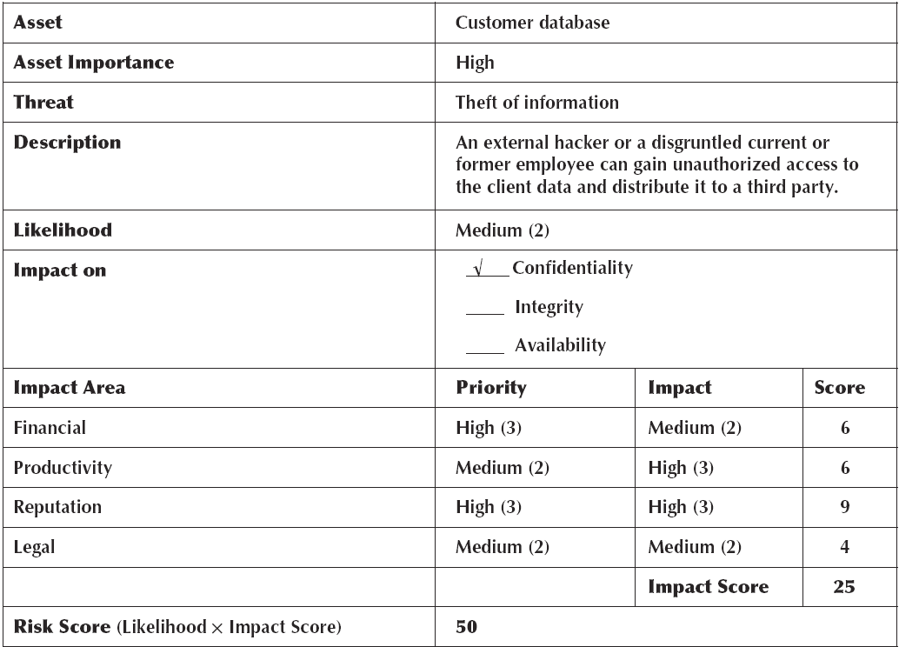
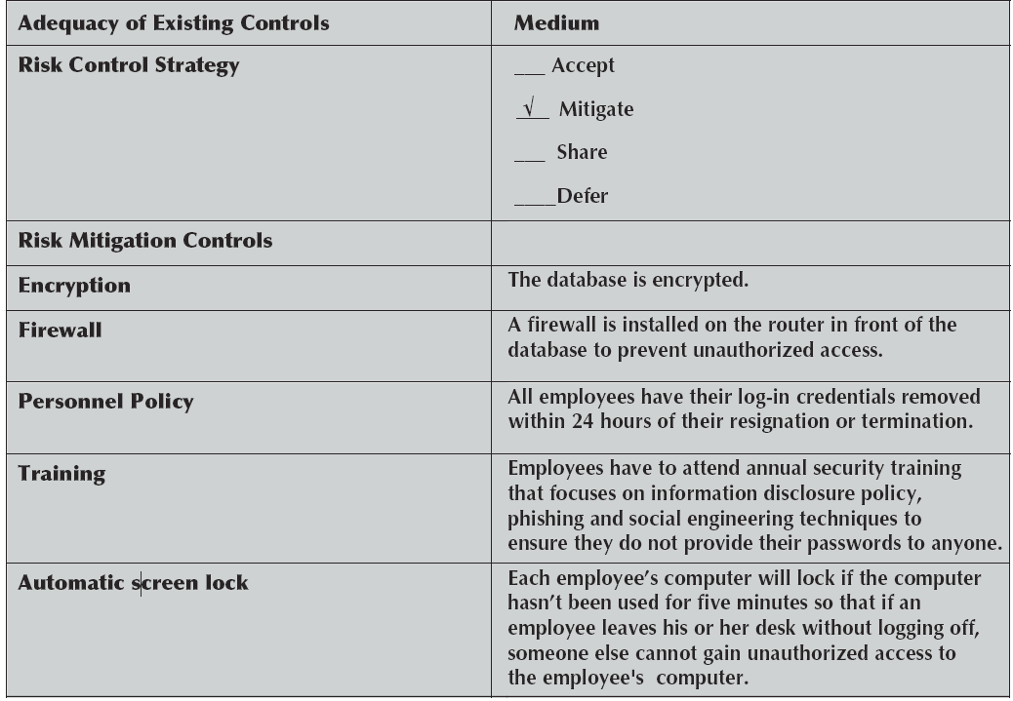
Sample Threat Scenario for Theft of Customer Information

Slide 22
11.3 Ensuring Business Continuity
Business continuity means that the organization’s data and applications will continue to operate even in the face of disruption, destruction, or disaster
A business continuity plan has two major parts:
The development of controls that will prevent these events from having a major impact on the organization
A disaster recovery plan that will enable the organization to recover if a disaster occurs

Slide 23
Major Threats to Business Continuity
Viruses
Theft
Denial of service attacks
Device failure
Disaster

Slide 24
Virus Protection
Special attention must be paid to preventing malware such as computer viruses and ransomware.
Most malware attaches itself to other programs or USB drives.
Macro viruses can spread when an infected file is simply opened
Viruses that are contained in documents, emails, or spreadsheet files.
A worm is a special type of virus that spreads itself without human intervention.
The best way to prevent the spread of viruses is to install antivirus software.
Malware is often spread by downloading files from the Internet.

Slide 25
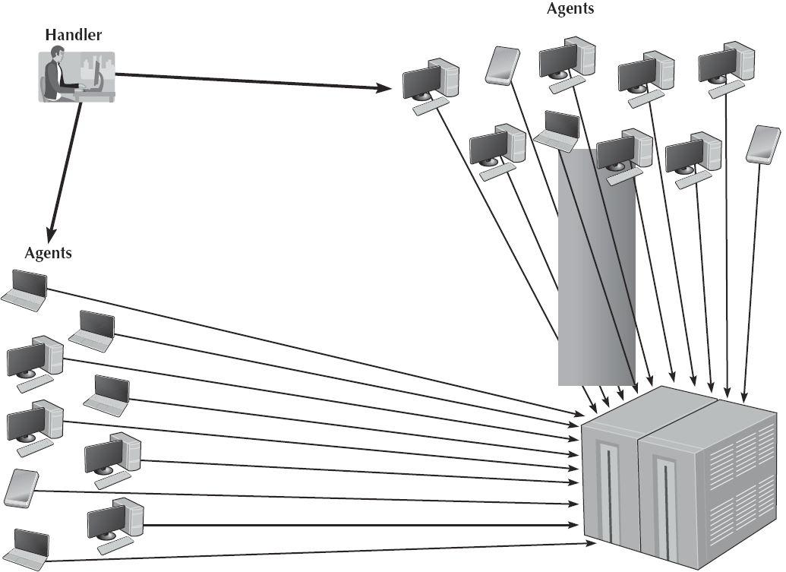
Denial-of-Service Protection
With a denial-of-service (DoS) attack, an attacker attempts to disrupt the target by flooding it with messages.
Also called a distributed denial-of-service (DDoS) attack.
The simplest approach is to flood it with incoming messages
Some DDos attacks have sent more than one billion packets per second at the target.

Slide 26
Denial-of-Service Protection Continued
The attacker breaks into and takes control of thousands computers or smart device and plants software on them
Called a DDoS agent, or zombie, or bot
The attacker then uses software called a DDoS handler to control the agents
Sometimes called a botnet

Slide 27
Preventing DoS and DDoS Attacks from Affecting the Network
Configure the main router that connects your network to the Internet to verify that the source address of all incoming messages is in a valid address range for that connection.
Called traffic filtering
Configure the main router (or firewall) to limit the number of incoming packets that could be DoS/DDoS attack packets that it allows to enter the network
Called traffic limiting
Use a special-purpose security device, called a traffic anomaly detector

Slide 28
Device Failure Protection
Eventually, every computerized device will fail
The best way to prevent a failure from impacting business continuity is to build redundancy into the network.
Internet connection
Core backbone
Each access layer LAN
Redundancy can be expensive
Redundancy also applies to servers
Some organizations use fault-tolerant servers
An uninterruptible power supply (UPS) is a device that detects power failures and permits the devices attached to it to continue to operate.

Slide 29
Redundant Array of Independent Disks
Redundant array of independent disks (RAID) is a storage technology that is made of many separate disk drives.
When a file is written to a RAID device, it is written across several separate, redundant disks
RAID 0 uses multiple disk drives and therefore is faster than traditional storage
RAID 1 writes duplicate copies of all data on at least two different disks
RAID 2 provides error checking to ensure no errors have occurred during the reading or writing process
RAID 3 provides a better and faster error checking
RAID 4 provides slightly faster read access
RAID 5 provides slightly faster read and write access
RAID 6 can survive the failure of two drives with no data loss.

Slide 30
QUIZ 6
The key principle in preventing disruption, destruction and disaster is ___________.
redundancy
control spreadsheet
prevention controls
anti-virus software
Ans: a. redundancy

Slide 31
QUIZ 7
A hacker gaining access to organizational data files and resources is an example of a(n) ____________ threat.
disruptive
controlled chaos
destruction
intrusion
disaster
Ans: d. intrusion

Slide 32
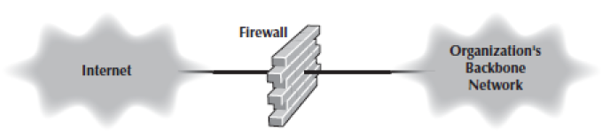
Using a Firewall to Protect Networks
A firewall is commonly used to secure an organization’s Internet connection.
It is a router or special-purpose device that examines packets flowing into and out of a network and restricts access to the organization’s network.
The network is designed so that a firewall is placed on every network connection between the organization and the Internet.

Slide 33
Types of Firewalls
Packet-level firewall
Application-level firewall
Network address translation firewall

Slide 34
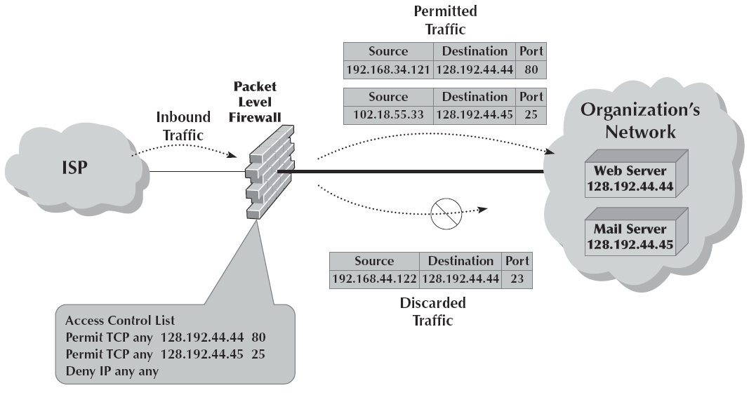
Packet-Level Firewall
A packet-level firewall examines the source and destination address of every network packet that passes through it.
It only allows packets into or out of the organization’s networks that have acceptable source and destination addresses.
The network manager writes a set of rules (called an access control list [ACL]) for the packet-level firewall.

Slide 35
Application-Level Firewalls
An application-level firewall is more expensive and more complicated to install and manage than a packet-level firewall.
They have rules for each application they can process.
Application-level firewalls can use stateful inspection.
This means that they monitor and record the status of each connection and can use this information in making decisions about what packets to discard as security threats.
Many application-level firewalls prohibit external users from uploading executable files.

Slide 36
Encryption
One of the best ways to prevent intrusion is encryption>
Encryption is the process of disguising information.
Decryption is the process of restoring it to readable form.
When information is in readable form, it is called plaintext; when in encrypted form, it is called ciphertext.
There are two fundamentally different types of encryption: symmetric and asymmetric
With symmetric encryption, the key used to encrypt a message is the same as the one used to decrypt it.
With asymmetric encryption, the key used to decrypt a message is different from the key used to encrypt it.

Slide 37
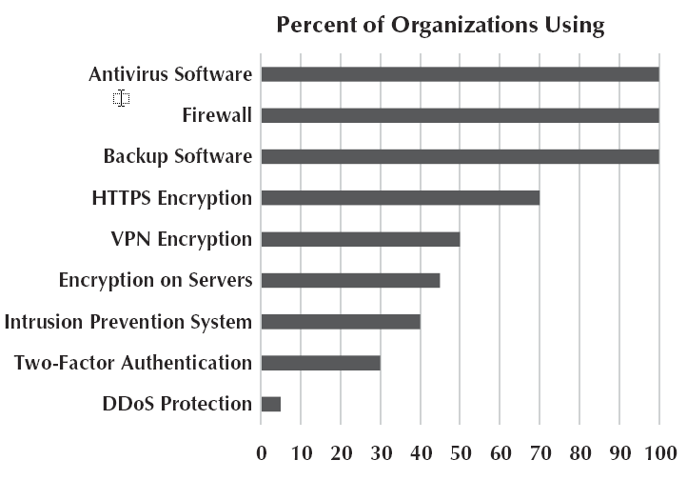
11.5 Best Practice Recommendations
Good security starts with a clear disaster recovery plan and a solid security policy.
Probably the best security investment is user training.
The chart at right shows the most commonly used security controls.
We expect two-factor authentication and encryption to become much more popular.

Slide 38
11.6 Implications for Cyber Security
Cyber security is the fastest-growing area in information systems.
The good news is there are plenty of job opportunities
The bad news is that you as a user will have to be more concerned with security than ever before.
Professionally and personally
Subscribe to an automatic backup service.
Keep software up-to-date.
Use passphrases
Lock your phone.

Slide 39
Optional (Extra materials)

Slide 40
Threat Scenario
A threat scenario begins with the name of the asset and the threat being considered.
Next, the consequences of the threat are assessed, using the impact areas identified in step 1 and their priority.
Finally, we can calculate the relative risk score by multiplying the impact score by the likelihood.

Slide 41
Document Existing Controls
The risk control strategy is the way an organization intends to address a risk.
In general, there are four ways an organization can address risk:
If an organization decides to accept a risk, it means the organization will be taking no action to address it and accept the stated consequences.
Risk mitigation involves implementation of some type of a control to counter the threat or to minimize the impact.
An organization can decide to share the risk, typically by buying insurance.
The organization can defer the risk, which usually happens when there is a need to collect additional information about the threat and the risk.

Slide 42
Identify Improvements
The final step in risk assessment is to identify what improvements are needed.
Most organizations face so many threats that they cannot afford to mitigate all of them.
They need to focus first on the highest risks.
The second focus is on threat scenarios whose mitigation controls have low adequacy.

Slide 43
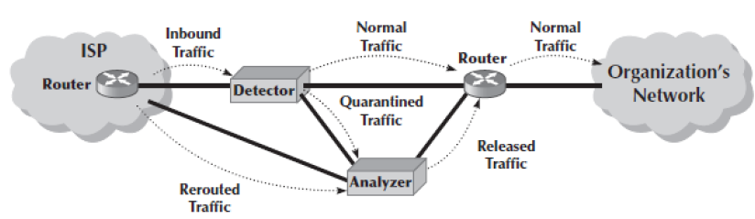
Traffic Anomaly Detector
A traffic anomaly detector is installed in front of the main router
It monitors normal traffic patterns and learns what normal traffic looks like
When it recognizes a DoS/DDoS attach, it quarantines those incoming packets but allows normal traffic to flow through into the network

Slide 44
Theft Protection
One often overlooked security risk is theft.
Physical security is a key component of theft protection.
One of the most common targets for theft is laptop computers.

Slide 45
Disaster Protection
A disaster is an event that destroys a large part of the network and computing infrastructure in one part of the organization
Disasters are usually (but not always) caused by natural forces
Want to avoid a disaster if possible
Redundancy
Other steps depend on the disaster to be avoided
A critical element in correcting problems from a disaster is the disaster recovery plan
Should address various levels of response to a number of possible disasters and should provide for partial or complete recovery

Slide 46
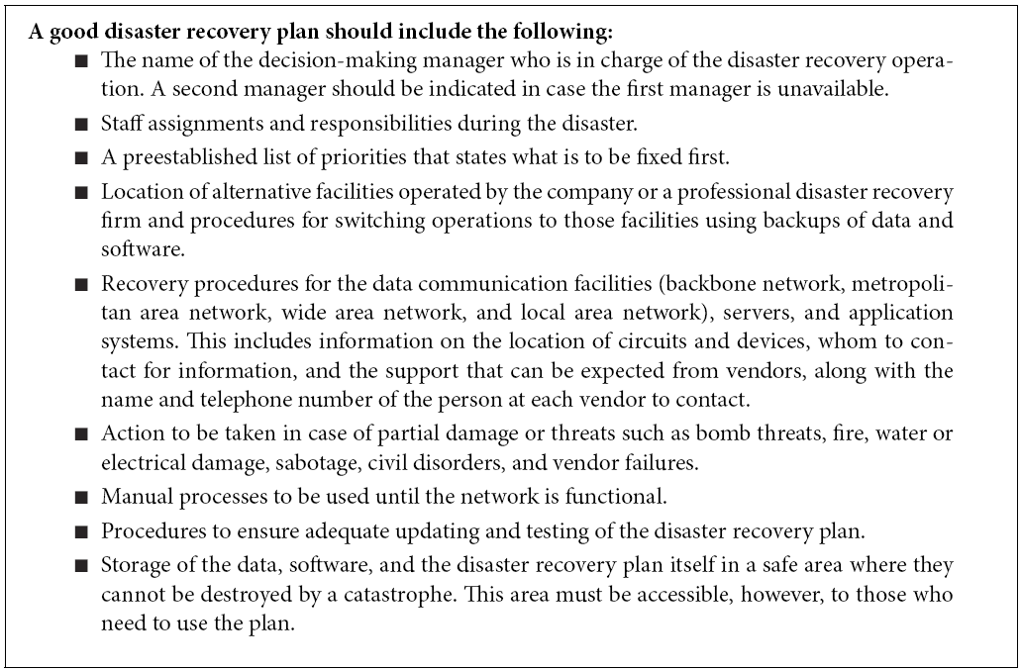
Elements of a Disaster Recovery Plan

Slide 47
More on Disaster Recovery
The most important elements of the disaster recovery plan are backup and recovery controls that enable the organization to recover its data and restart its application software
Continuous data protection (CDP) is another option that firms are using in addition to or instead of regular backups
With CDP, copies of all data and transactions on selected servers are written to CDP servers as the transaction occurs
A disaster recovery drill tests the disaster recovery plan and provides staff the opportunity to practice their skills

Slide 48
Disaster Recovery Outsourcing
Most large organizations have a two-level disaster recovery plan:
When they build networks, they build enough capacity and have enough spare equipment to recover from a minor disaster such as loss of a major server or a portion of the network
Most large organizations rely on professional disaster recovery firms to provide second-level support for major disasters
Full service disaster recover firms include a complete networked data center that clients can use when they experience a disaster

Slide 49
11.4 Intrusion Prevention
Intrusion is the second main type of security problem and the one that tends to receive the most attention
Four types of intruders may attempt to gain unauthorized access to computer networks:
The first are casual intruders who have only a limited knowledge of computer security (script kiddies)
The second type of intruders are experts in security, but their motivation is the thrill of the hunt (hackers and crackers)
The third type of intruders are professional hackers who break into corporate or government computers for specific purposes, such as espionage, fraud, or intentional destruction
The fourth type of intruders are organization employees who have legitimate access to the network but who gain access to information they are not authorized to use

Slide 50
Security Policy
A security policy is critical to controlling risk due to intrusion
It should clearly define the important assets to be safeguarded and the important controls needed to do that
It should have a section devoted to what employees should and should not do

Slide 51
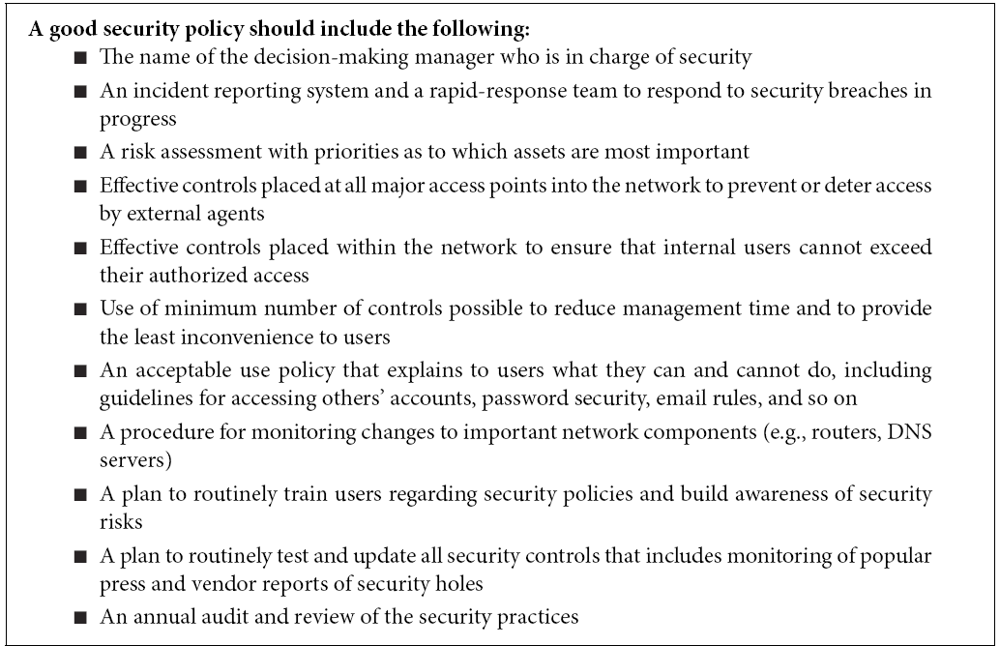
Elements of a Security Policy

Slide 52
Perimeter Security and Firewalls
Ideally, you want to stop external intruders at the perimeter of your network so that they cannot reach the servers inside
There are three basic access points into most networks:
Internet
LANs
WLANs
Most common access point for intrusion is the Internet connection
For this reason, the focus of perimeter security is usually on the Internet connection, although physical security is also important

Slide 53
Network Address Translation (NAT) Firewalls
Network address translation (NAT) is the process of converting between one set of public IP addresses that are viewable from the Internet and a second set of private IP addresses that are hidden from people outside of the organization
NAT is transparent
If external intruders on the Internet can not see the private IP addresses inside your organization, they can’t attack your computers
Most routers and firewalls today have NAT built into them
The NAT firewall uses an address table to translate the private IP addresses used inside the organization into proxy IP addresses used on the Internet

Slide 54
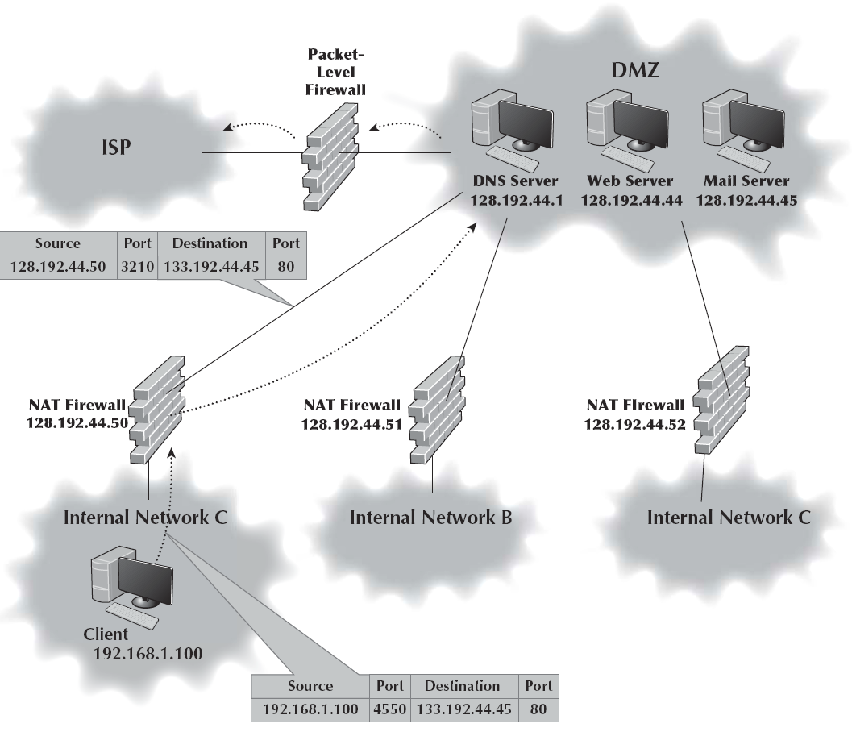
Firewall Architecture
Many organizations use layers of NAT, packet-level, and application-level firewalls
Packet-level firewalls are used as an initial screen from the Internet into a network devoted solely to servers intended to provide public access
Each major portion of the organization’s internal networks has its own NAT firewall to grant (or deny) access

Slide 55
Security Holes
The servers and client computers on a network may not be safe because of security holes
A security hole is simply a bug that permits unauthorized access
Many security holes have been documented and “patches” are available from vendors to fix them
Not everyone applies the patches
Once a security hole is discovered, it is quickly circulated through the Internet
Attacks that take advantage of a newly discovered security hole before a patch is developed are called zero-day attacks

Slide 56
Operating Systems
The American government requires certain levels of security in the operating systems and network operating systems it uses for certain applications
The minimum level of security is C2
Most major operating systems provide at least C2
Windows
Windows applications regularly access and make changes to critical parts of the operating system
Hostile applications can easily take over the computer and literally do whatever they want without the user knowing

Slide 57
Trojan Horses
Trojan horses are remote access management consoles that enable users to access a computer and manage it from afar
Sometimes called rootkits
Trojans are often concealed in other software that unsuspecting users download over the Internet.
More recently, Trojans have morphed into tools such as MoSucker and Optix Pro
These attack consoles now have one-button clicks to disable firewalls, antivirus software, and any other defensive process
Spyware, adware, and DDoS agents are three types of Trojans

Slide 58
Symmetric Encryption
Symmetric encryption has two parts: the algorithm and the key
Also called single-key encryption
Because the same key is used to encrypt and decrypt, symmetric encryption can cause problems with key management
Good encryption systems do not depend on keeping the algorithm secret
Only the keys need to be kept secret
One commonly used encryption technique is the Data Encryption Standard (DES)
Triple DES (3DES) is a newer standard that is harder to break
The NIST’s new standard, called Advanced Encryption Standard (AES)
The U.S. government considers encryption to be a weapon and regulates its export

Slide 59
Public Key Encryption
Public key encryption is asymmetric so there are two keys
The public key is used to encrypt the message
The private key is used to decrypt the message
Public key systems are based on one-way functions
Public key encryption greatly reduces the key management problem

Slide 60
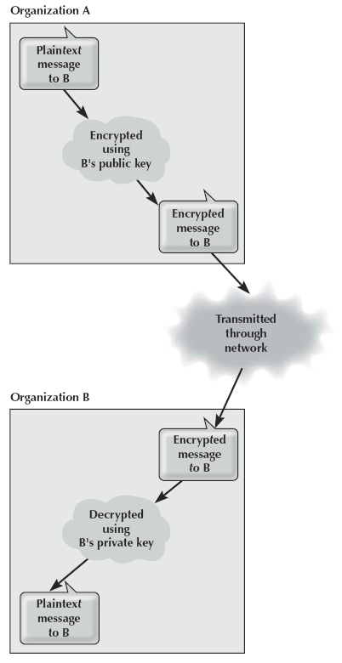
Secure Transmission with Public Key Encryption
All public keys are published in a directory
Sender encrypts the message using the public key
Encrypted message is sent to receiver
Receiver decrypts using the private key
Public key cannot be used to decrypt

Slide 61
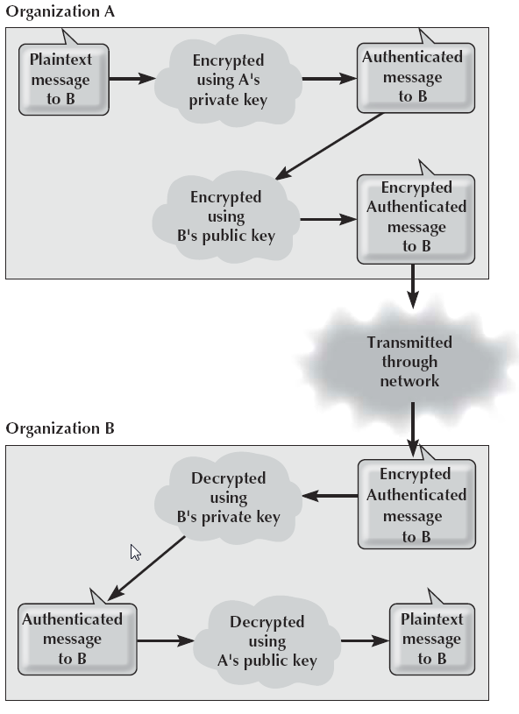
Authenticated and Secure Transmission with Public Key Encryption
Public key encryption also permits the use of digital signatures through a process of authentication
Public key encryption algorithms are invertible, meaning that text encrypted with either key can be decrypted by the other
Normally, we encrypt with the public key and decrypt with the private key
It is possible to do the reverse

Slide 62
Authenticated and Secure Transmission with Public Key Encryption Continued
Because the private key is secret, only the real user could use it to encrypt a message
Thus, a digital signature or authentication sequence is used as a legal signature on many financial transactions
The only problem is ensuring the person or organization who sent the document is really the person or organization it claims to be

Slide 63
Public Key Infrastructure (PKI)
Verifying identity is where the Internet’s PKI becomes important
The PKI is a set of hardware, software, organizations, and polices designed to make public key encryption work on the Internet
PKI begins with a certificate authority (CA), which is a trusted organization that can vouch for the authenticity of the person or organization using authentication
The CA issues a digital certificate that is the requestor’s public key encrypted using the CA’s private key as proof of identity

Slide 64
Encryption Software
Pretty Good Privacy (PGP) is a freeware public key encryption package developed by Philip Zimmermann that is often used to encrypt email
Secure Sockets Layer (SSL) is an encryption protocol widely used on the Web
SSL encrypts outbound packets coming out of the application layer before they reach the transport layer and decrypts inbound packets coming out of the transport layer before they reach the application layer
IP Security Protocol (IPSec) is another widely used encryption protocol
It differs from SSL in that SSL is focused on Web applications, whereas IPSec can be used with a much wider variety of application layer protocols

Slide 65
IP Security Protocol Continued
IP Security Protocol can operate in either transport mode or tunnel mode for VPNs
In IPSec transport mode, IPSec encrypts just the IP payload, leaving the IP packet header unchanged so it can be easily routed through the Intern
In IPSec tunnel mode, IPSec encrypts the entire IP packet and must, therefore, add an entirely new IP packet that contains the encrypted packet as well as the IPSec AH or ESP packets

Slide 66
User Authentication
Once the network perimeter and the network interior have been secured, the next step is to ensure that only authorized users are permitted into the network
This is called user authentication
The basis of user authentication is the user profile for each user’s account
One security problem is the removal of user accounts when someone leaves an organization
Often, network managers are not informed of the departure
If the staff member’s departure was not friendly, there is a risk that they may attempt to access data and resources and use them for personal gain, or destroy them to get back at the organization

Slide 67
User Authentication Continued
Gaining access to an account can be based on something you know, something you have, or something you are
The most common approach is something you know, usually a password
Some organizations have moved to passphrases
Password managers are becoming more common
Entering a password in conjunction with something you have is called two-factor authentication
Two-factor authentication commonly employs the user’s mobile phone
Another approach is one-time passwords
Biometric systems scan the user (fingerprint, retina) to ensure that the user is the sole individual authorized to access the network account

Slide 68
Central Authentication
One long-standing problem has been that users are often assigned user profiles and passwords on several different computers
More and more organizations are adopting central authentication
Instead of logging into a file server or application server, the user logs into the authentication server
It issues a certificate if the user is authorized
The most commonly used authentication protocol is Kerberos

Slide 69
Preventing Social Engineering
One of the most common ways for attackers to break into a system is through social engineering
Social engineering refers to breaking security simply by asking
Phishing is a very common type of social engineering
The attacker sends an email to millions of users telling them that their bank account has been shut down due to an unauthorized access attempt and that they need to reactivate it by logging in
After the user logs into the fake site, the attacker has the user’s user ID and password and can break into his or her account at will

Slide 70
Intrusion Prevention Systems
Intrusion prevention systems (IPSs) are designed to detect an intrusion and take action to stop it
There are two general types of IPS:
With a network-based IPS, an IPS sensor is placed on key network circuits
A host-based IPS is a software package installed on a host or server
Many network managers choose to install both
There are two fundamental techniques that these types of IPSs can use to determine that an intrusion is in progress:
Misuse detection, which compares monitored activities with signatures of known attacks
Anomaly detection, which works by comparing monitored activities with the “normal” set of activities
Most IPSs use both techniques

Slide 71
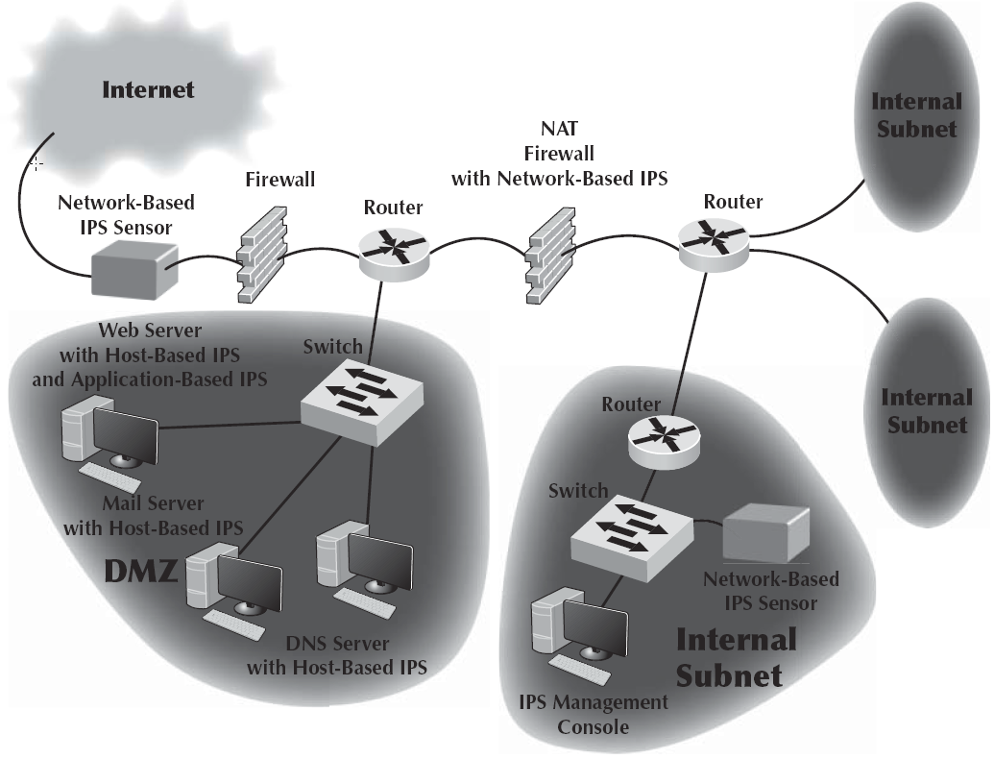
Intrusion Prevention Systems Continued
Intrusion prevention systems are often used in conjunction with other security tools such as firewalls
In fact, some firewalls are now including IPS functions
IPS monitoring has little value unless there is a clear plan for responding to a security breach in progress
Responding to an intrusion can be more complicated than it at first seems

Slide 72
Intrusion Recovery
Once an intrusion has been detected, the first step is to identify how the intruder gained unauthorized access and prevent others from breaking in the same way
Computer forensics is the use of computer analysis techniques to gather evidence for criminal and/or civil trials
Some organizations have taken their own steps to snare intruders by using entrapment techniques
A honey pot is an attractive server that contains only fake information

